Slide 1

Starting Out with C++ Early Objects
Tenth Edition
Chapter 20
Binary Trees

Slide 2
Topics
20.1 Definition and Applications of Binary Trees
20.2 Binary Search Tree Operations
20.3 Template Considerations for Binary
Search Trees

Slide 3
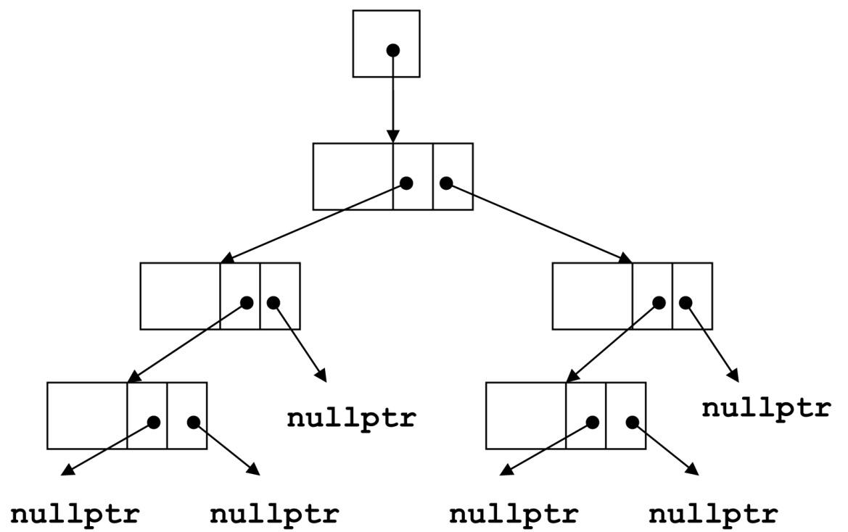
20.1 Definition and Applications of Binary Trees
Binary tree: a nonlinear data structure in which each node may point to 0, 1, or two other nodes
The nodes that a node
N points to are the
(left or right)
children
of N

Slide 4
Terminology
If a node N is a child of another node P, then P is called the parent of N
A node that has no children is called a leaf node
In a binary tree there is a unique node with no parent. This is the root of the tree. Every node other than the root of the tree has exactly one parent.

Slide 5
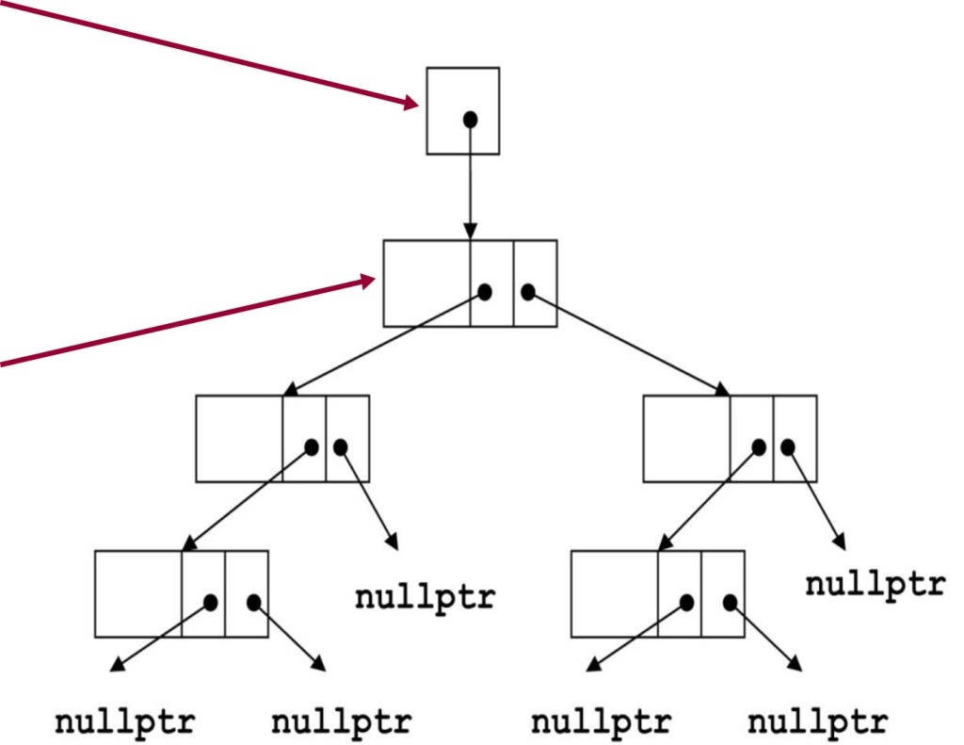
Binary Tree Terminology
Root pointer: like a head pointer for a linked list, it points to the root node of the binary tree
Root node: the node with no parent. Similar to the head of a linked list.

Slide 6
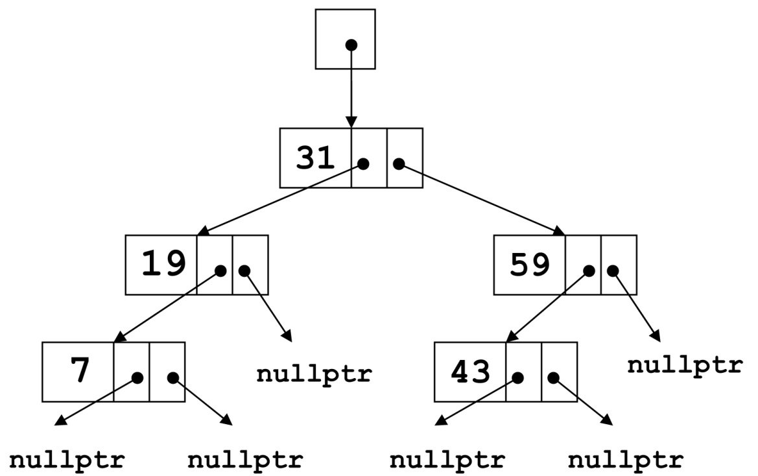
Binary Tree Terminology 1 of 5
Leaf nodes: nodes that have no children
The nodes containing 7 and 43 are leaf nodes

Slide 7
Binary Tree Terminology 2 of 5
Child nodes, children:
The children of the node containing 31 are the nodes containing 19 and 59

Slide 8
Binary Tree Terminology 3 of 5
The parent of the node containing 43 is the node containing 59

Slide 9
Binary Tree Terminology 4 of 5
A subtree of a binary tree is a part of the tree from a node N down to the leaf nodes
Such a subtree is said to be rooted at N, and N is called the root of the subtree

Slide 10
Subtrees of Binary Trees
A subtree of a binary tree is itself a binary tree
A nonempty binary tree consists of a root node, with the rest of its nodes forming two subtrees, called the left and right subtree

Slide 11
Binary Tree Terminology 5 of 5
The node containing 31 is the root
The nodes containing 19 and 7 form the left subtree
The nodes containing 59 and 43 form the right subtree

Slide 12
Uses of Binary Trees
Binary search tree: a binary tree whose data is organized to simplify searches
Left subtree at each node contains data values less than the data in the node
Right subtree at each node contains values greater than the data in the node

Slide 13
20.2 Binary Search Tree Operations
Create a binary search tree
Insert a node into a binary tree – put node into tree in its correct position to maintain order
Find a node in a binary tree – locate a node with particular data value
Delete a node from a binary tree – remove a node and adjust links to preserve the binary tree and the order

Slide 14
Binary Search Tree Node
A node in a binary tree is like a node in a linked list, except that it has two node pointer fields:
struct TreeNode
{
int value;
TreeNode *left;
TreeNode *right;
};
A constructor with default values can aid in the creation of nodes.
Notes:
See IntBinaryTree.h

Slide 15
TreeNode Constructor
TreeNode::TreeNode(int val,
TreeNode *l1=NULL,
TreeNode *r1=NULL)
{
value = val;
left = l1;
right = r1;
}

Slide 16
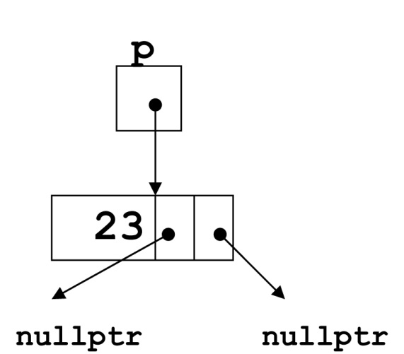
Creating a New Node
TreeNode *p;
int num = 23;
p = new TreeNode(num);

Slide 17
Inserting an item into a Binary Search Tree 1 of 2
If the tree is empty, replace the empty tree with a new binary tree consisting of the new node as root, with empty left and right subtrees
Otherwise, if the item is less than the root node, recursively insert the item in the left subtree. If the item is greater than the root node, recursively insert the item into the right subtree
Notes:
See IntBinaryTree.h, IntBinaryTree.cpp, and pr20-01.cpp

Slide 18
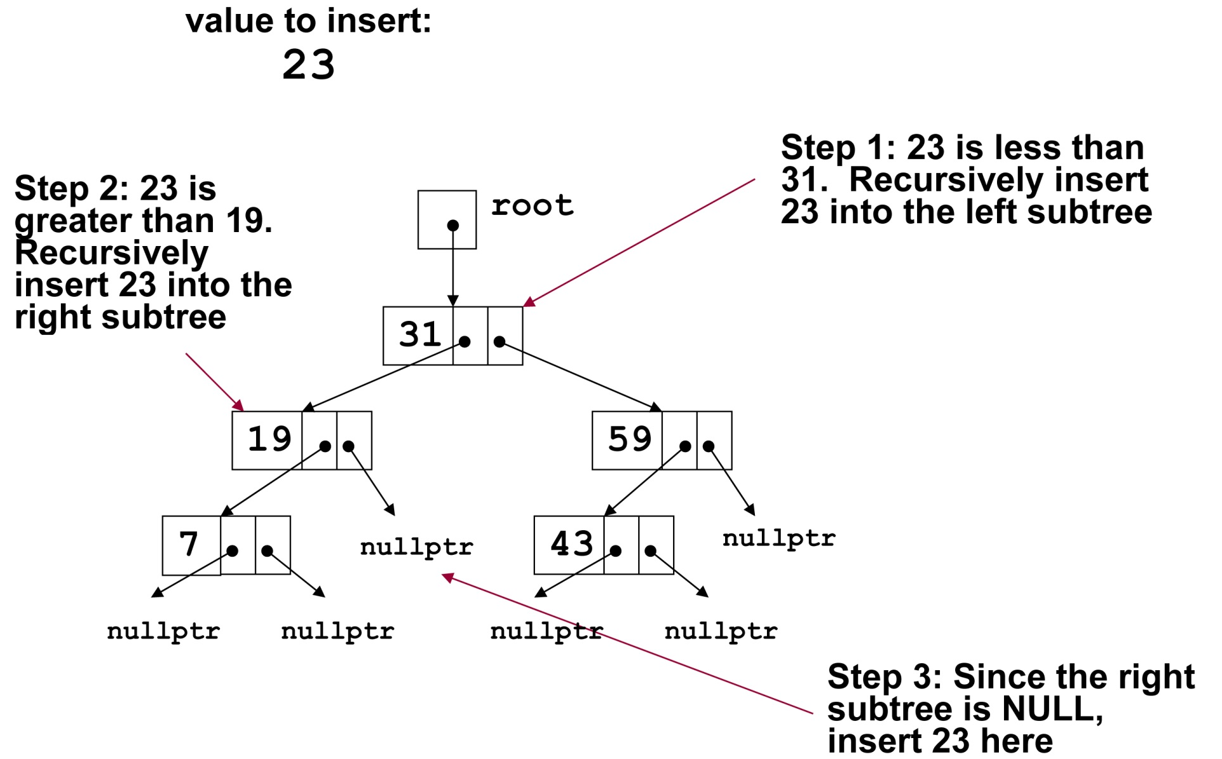
Inserting an item into a Binary Search Tree 2 of 2

Slide 19
Traversing a Binary Tree 1 of 2
Three traversal methods:
Inorder:
Traverse left subtree of node
Process data in node
Traverse right subtree of node
Preorder:
Process data in node
Traverse left subtree of node
Traverse right subtree of node
Postorder:
Traverse left subtree of node
Traverse right subtree of node
Process data in node

Slide 20
Traversing a Binary Tree 2 of 2
TRAVERSAL METHOD | NODES ARE VISITED IN THIS ORDER
Inorder | 7, 19, 31, 43, 59
Preorder | 31, 19, 7, 59, 43
Postorder | 7, 19, 43, 59, 31
Notes:
See IntBinaryTree.h, IntBinaryTree.cpp, and pr20-02.cpp

Slide 21
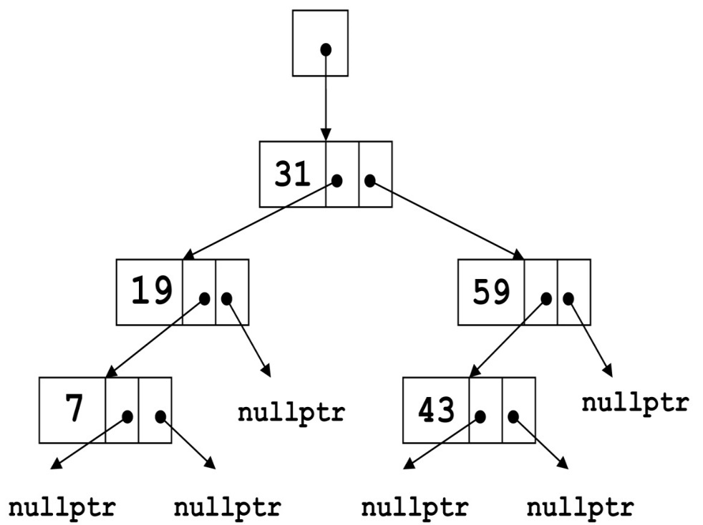
Searching in a Binary Tree 1 of 2
Start at root node
Examine node data:
Is it desired value? Done
Else, is desired data < node data? Repeat step 2 with left subtree
Else, is desired data > node data? Repeat step 2 with right subtree
Continue until desired value found or NULL pointer reached
Notes:
See IntBinaryTree.h, IntBinaryTree.cpp, and pr20-03.cpp

Slide 22
Searching in a Binary Tree 2 of 2
To locate the node containing 43,
Examine the root node (31)
Since 43 > 31, examine the right child of the node containing 31, (59)
Since 43 < 59, examine the left child of the node containing 59, (43)
The node containing 43 has been found

Slide 23
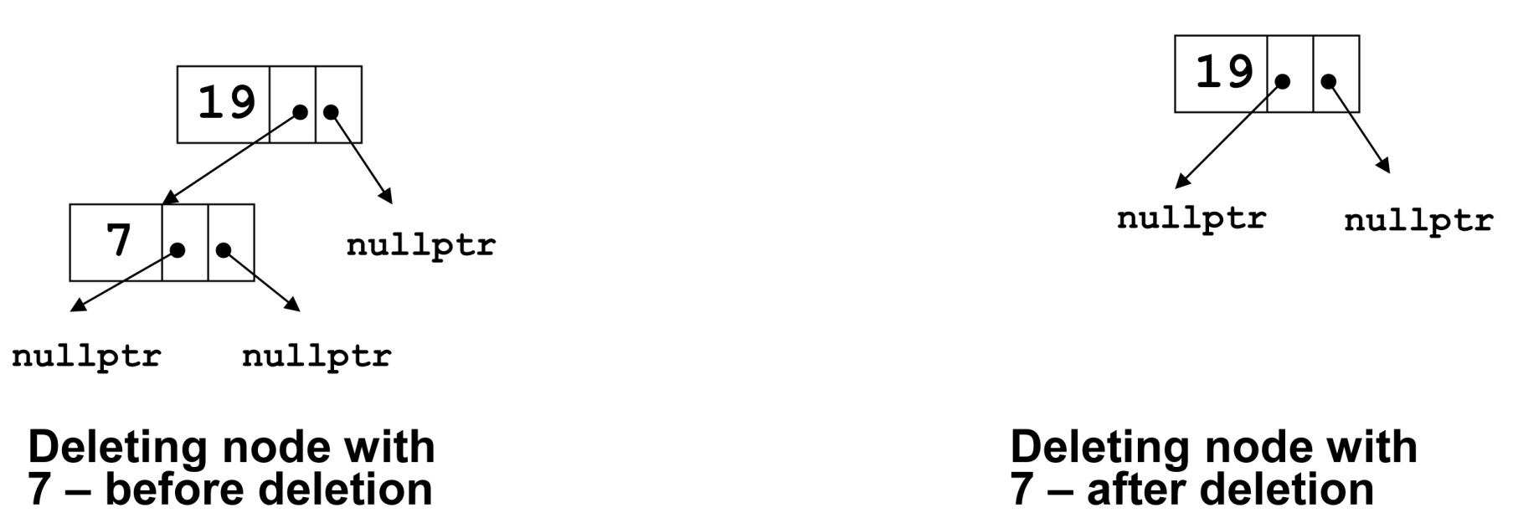
Deleting a Node from a Binary Tree – Leaf Node
If node to be deleted is a leaf node, replace parent node’s pointer to it with nullptr, then delete the node

Slide 24
Deleting a Node from a Binary Tree – One Child 1 of 2
If the node to be deleted has one child node, adjust the pointers so that parent of the node to be deleted points to child of the node to be deleted, then delete the node

Slide 25
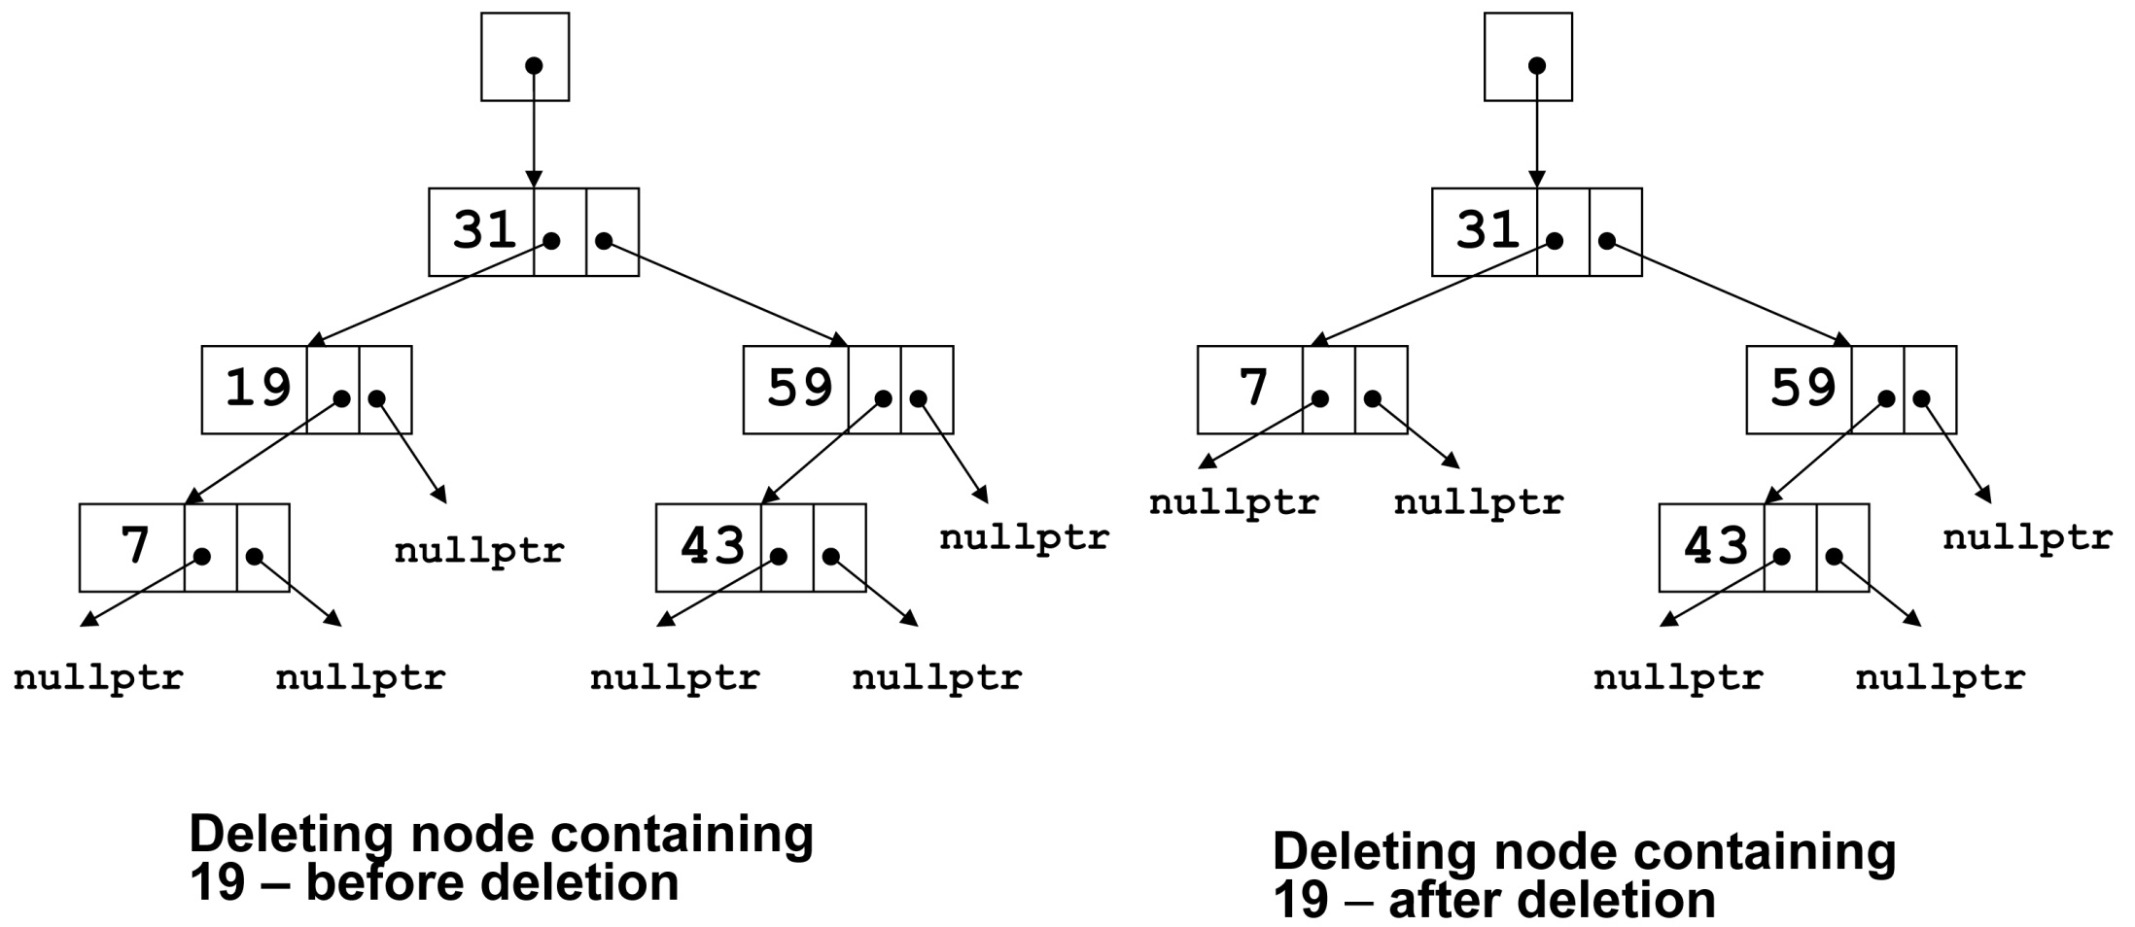
Deleting a Node from a Binary Tree – One Child 2 of 2

Slide 26
Deleting a Node from a Binary Tree – Two Children 1 of 2
If node to be deleted has left and right children,
‘Promote’ one child to take the place of the deleted node
Locate correct position for other child in subtree of promoted child
Convention in the text: “attach" the right subtree to its parent, then position the left subtree at the appropriate point in the right subtree.
Care must be taken when re-attaching the left subtree to maintain the search property of a binary search tree.

Slide 27
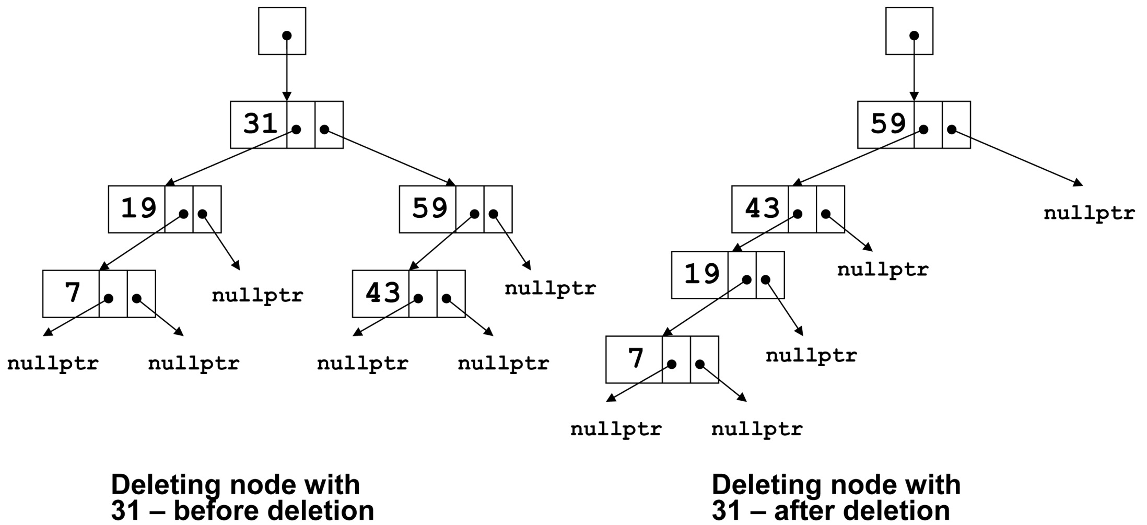
Deleting a Node from a Binary Tree – Two Children 2 of 2
Notes:
See IntBinaryTree.h, IntBinaryTree.cpp, and pr20-04.cpp

Slide 28
20.3 Template Considerations for Binary Search Trees
A binary tree can be implemented as a template, allowing flexibility in determining the type of data stored
The implementation must support relational operators >, <, and == to allow for the comparison of nodes

Slide 29

Copyright

